Slide 1

The Real Estate Portal
DOĞUKAN GÜLER: 17000252
ALEYNA YILMAZ: 21000166
FATİH ÇAKIR: 21000128
Group No: 5

Slide 2

THE OVERVIEW
The Introduction
Project Management
Overall Description
Functional Requirements
Nonfunctional Requirements
User Interface
Conclusion

Slide 3

THE INTRODUCTION
Purpose:
Real estate search portal is a website designed to facilitate transactions such as real estate search, purchase, sale, rental and evaluation. This portal allows users to view, compare and query properties available in local or international markets.
System Scope:
The system scope includes a description of the functions and features that the portal offers. System scope is determined by the portal's goals, audiences, requirements, constraints, and assumptions.

Slide 4

Operating Environment:
The operating environment refers to the hardware, software, network and security components on which the portal runs.
Design and Implementation:
Design and implementation constraints are factors that affect the development and operation of the portal. Design and implementation constraints ensure that the portal complies with technical, business, legal and ethical standards.

Slide 5
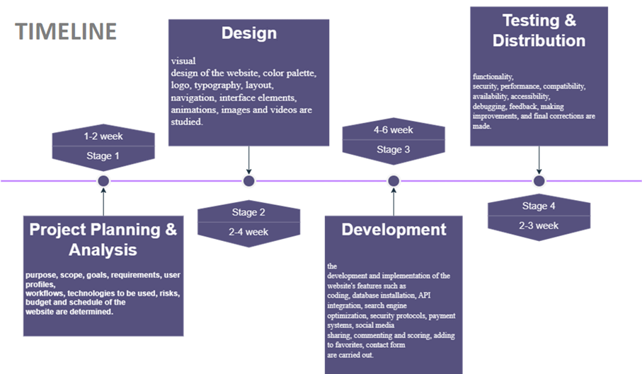
PROJECT MANAGEMENT

Slide 6
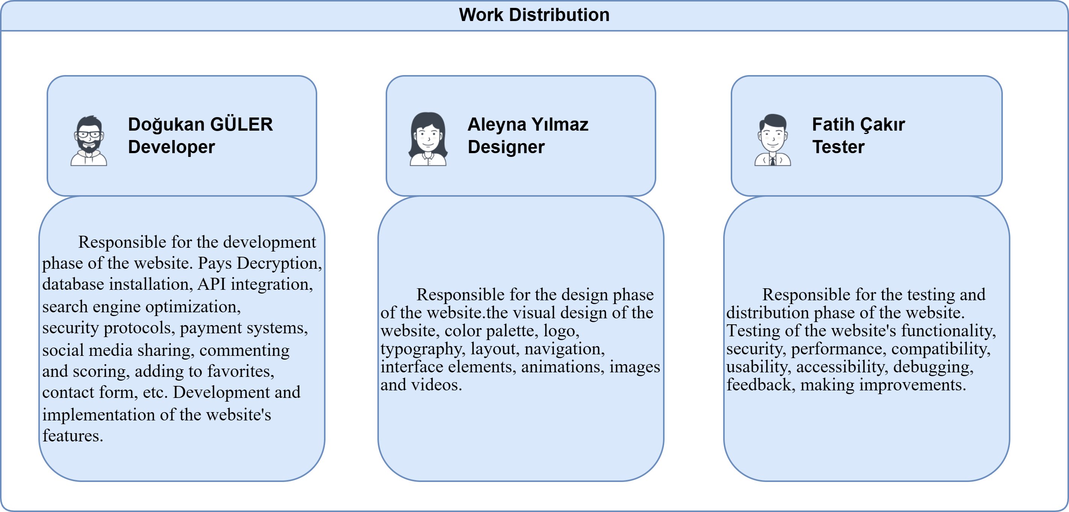

Slide 7

OVERALL DESCRIPTION
SYSTEM ARCHITECTURE
USE CASES
CLASS DIAGRAM

Slide 8
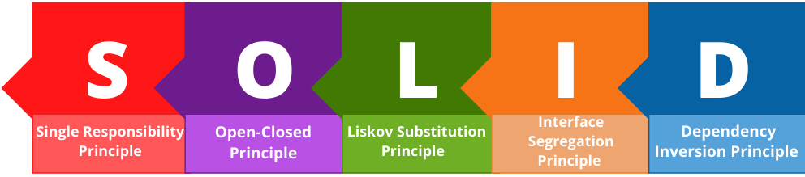
SYSTEM ARCHITECTURE

Slide 9

Single Responsibility Principle:
This principle says that each class or module should have only one responsibility. This way, the code is easier to read, test and modify.
Open-Closed Principle:
This principle states that software components should be closed to change but open to extension. This way, the code becomes more stable, secure and compatible.
Liskov Substitution Principle:
This principle states that subclasses of a class can be used in place of its superclass. This way, the code is more consistent, logical and reliable.

Slide 10
Interface Decomposition Principle:
This principle says that a class or module should not implement interfaces it does not need. This way, the code becomes simpler, clearer and more flexible.
Dependency Inversion Principle:
This principle says that software components should depend on abstractions but not on details. This way, the code is more independent, modular and amenable to change.

Slide 11
USE CASES
Use case 1: The user enters the portal's website, enters the desired location, property type, price range, number of rooms, square meters and other criteria in the search box, clicks the search button, the portal lists the properties suitable for the user, the user examines the list, compares the properties he likes, adds to the favourites adds, saves, shares or contacts advertisers.
Use case 2: The user downloads the portal's mobile application, opens the application, activates the location service, views properties near him, marks properties on the map, reads property details, watches property photos or videos, sees property reviews or ratings, sends a message to the advertiser if he likes the property, or calls.
Use case 3: The user enters the portal's website, selects moving services from the menu, enters the location to be moved, the date to be moved, the type of property to be moved to, the size of the property to be moved to and other information on the moving services page, the portal lists the moving companies suitable for the user, the user examines the list, the moving location he likes is He compares the companies, gets a quote, sees their comments or scores, and makes an agreement with the moving company.

Slide 12
Use case 4: The user enters the portal's website, selects the interior design solutions from the menu, enters the desired property type, property size, design style, budget and other information on the interior design solutions page, the portal lists the interior designers suitable for the user, the user examines the list, selects the interior he likes compares designers, sees their portfolios, comments or ratings, and contacts the interior designer.
Use case 5: The user enters the portal's website, selects legal consultancy services from the menu, enters the desired property type, property size, purchase-sale agreement, title deed transactions and other information on the legal consultancy services page, the portal lists the legal advisors suitable for the user, the user examines the list, compares the legal advisors he/she likes, sees their comments or scores, and contacts the legal advisor.
Use case 6: The user enters the portal's website, selects market trends from the menu, enters the desired location, property type, time period and other information on the market trends page, the portal shows the user relevant market trends, the user examines market trends, property prices, supply-demand It sees the balance, return on investment, competitive situation and other factors, and makes decisions based on market trends.

Slide 13
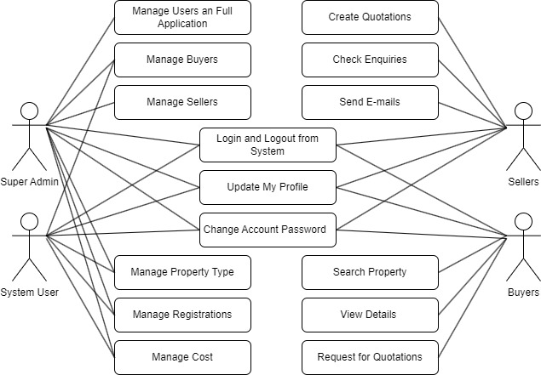
x
USE CASE DIAGRAM

Slide 14
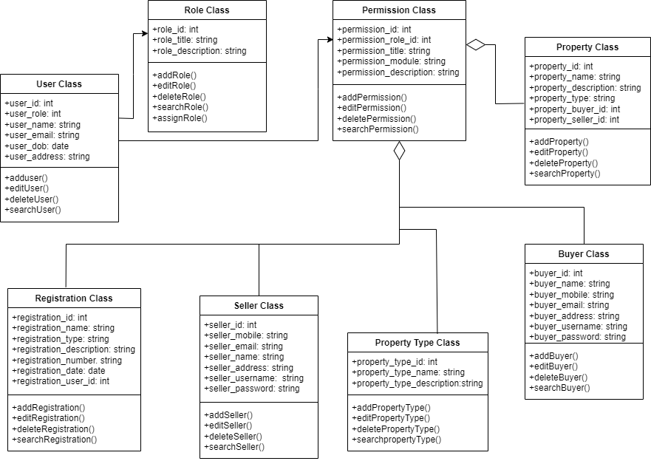
CLASS DIAGRAM

Slide 15
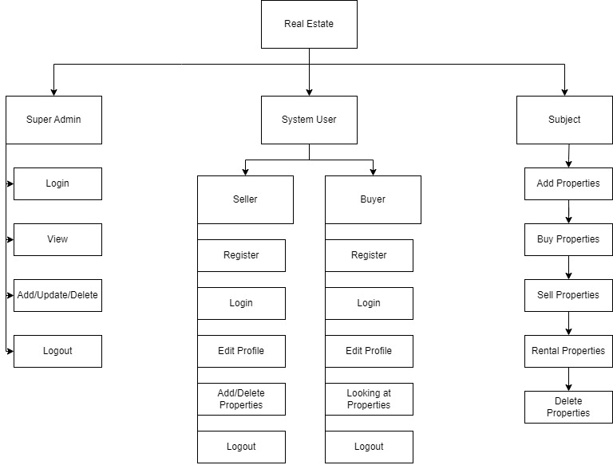
x
MODULAR HIERARCHY DIAGRAM

Slide 16
FUNCTIONAL REQUIREMENTS
User Requirements
REQ-1: Users can register and log in.
REQ-2: Users can manage their account.
REQ-3: Users can reset or update their passwords.
REQ-4: Users can use two-factor authentication.
REQ-5: Users can have the authority to review other users’ profiles.
REQ-6: Users can delete their accounts and their data if they want.

Slide 17
1.1 Buyer Requirements
• REQ-1: Buyer can search for properties and narrow down results with various filtering options.
• REQ-2: Buyer can add properties they like to favorite and access them easily later.
• REQ-3: The buyer can pay using secure payment methods.
1.2 Seller Requirements
• REQ-1: The seller can create a property listing and enter relevant information.
• REQ-2: The seller can edit or delete existing listings.
• REQ-3: The seller can review the statistics for listings
• REQ-4: The seller can start the sale transaction and receive payment.
• REQ-5: The sellers can display their properties on the location.
1.3 Admin Requirements
• REQ-1: The admin can create, edit, or close new or current user accounts.
• REQ-2: The admin can filter or delete inappropriate content.
• REQ-3: The admin can display and analyze general system statistics.
• REQ-4: The admin can reach database and display user data.
• REQ-5: The admin can check system backup operations.

Slide 18
NONFUNCTIONAL REQUIREMENTS
System Requirements
The website should load quickly.
The website should be open and accessible 24/7.
Security Requirements
The website should have an SSL certificate and protect the data of users.
The website should have a firewall which provides protection from DDoS attacks.

Slide 19
Usability Requirements
The website should have a user-friendly interface.
The website should work properly on the mobile platform, as well.
The website should have a live support assistant which 24/7 open.
Compatibility Requirements
The website should be compatible with different internet browsers and devices.
Maintenance
The system should update and maintain the website regularly.
The system should backup system data and being recoverable regularly.

Slide 20
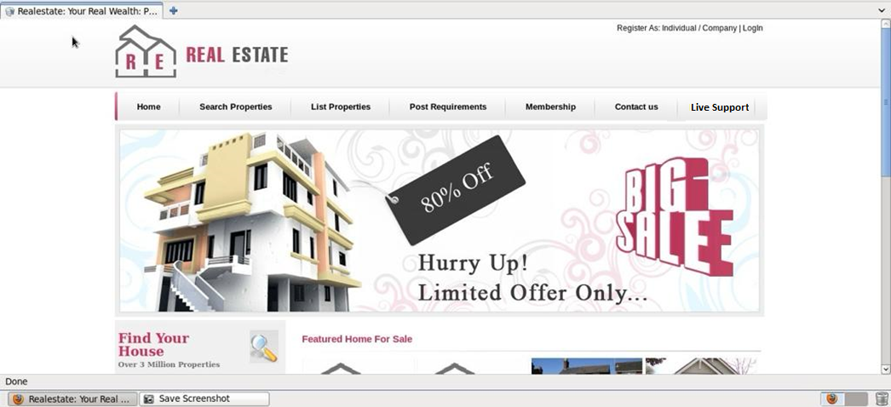
User Interface

Slide 21
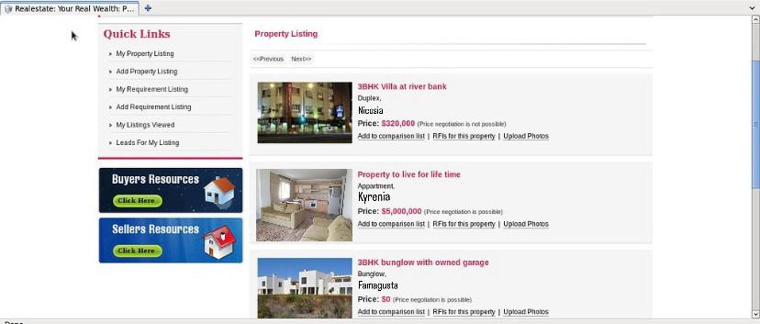

Slide 22
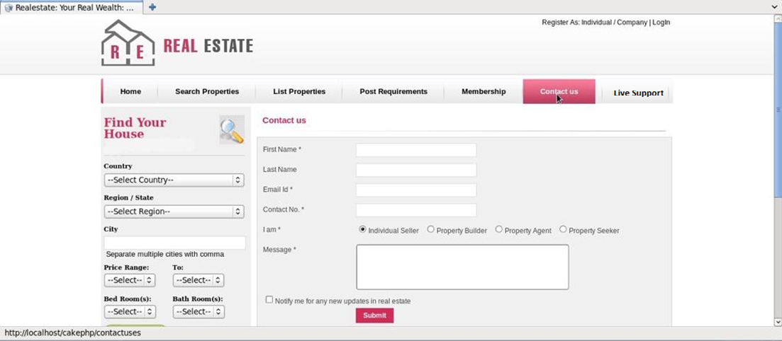

Slide 23

Conclusion
This report is a summary of the issues we pay attention to in making a real estate agent web application. In this report, we presented the design and development process of a real estate agent web application, as well as the content, target audience, competitive situation, legal obligations and revenue model of the web site.

